Slide 1
AAVAiL revenue projection – part 1 data investigation summary
RICHARD CURE
March-April 2021

Slide 2
contents
1. A) Assimilate the business scenario
1.B) Articulate testable hypotheses
2. State the ideal data to address the business opportunity and clarify the rationale for needing specific data
3. Create a Python script to extract relevant data from multiple data sources, automating the process of data ingestion
4. Investigate the relationship between the relevant data, the target and the business metric. A)-H)

Slide 3
1.a) Assimilate the business scenariO
AAVAiL customers outside the US have been subscribing to AAVAiL services ‘a la carte’ e.g. which is different to the way they have been doing so before.
This has created ~ 2 years of transactional data across a few 1000 customers.
These customers are dispersed across 38 different countries, and the transactional data comes in batch format, 1 JSON file per month.
AAVAiL product managers have found it difficult to predict monthly revenue.
Through a Design Thinking programme, a decision was made to start a new project to develop a machine learning model to project revenue for 10 of the 38 countries.
Product Manager expectations of the model are that it will save time over the existing revenue projections process, and that model outputs will be more accurate than outputs resulting from the existing process.
The possible positive business impacts are that the model will enable AAVAiL to stabilise counts of staff members, and will generate a ‘ripple effect’ drawn from budget projections.

Slide 4
1.b) articulate testable hypotheses.
Business Question | Hypothesis | Ideal Data needed | Data Descriptions
Does use of the new model save AAVAiL Product Managers time when projecting future revenue? | Use of the new model to generate a revenue projections is faster than use of the existing revenue projections process | 2 tables containing the below rows and columns, for pre- new model (existing process) and post-new model Rows: A single revenue projection made by an AAVAiL Product Manager Columns: Projection id Date/Time of projection Product Manager ID/Name Month of projection Country of projection Model version Model output/revenue projection(s) Time to execute projection | Projection id – uniquely identifies a projection Date/Time of projection – when the projection was executed Product Manager ID/Name – uniquely identifies a user Month of projection - month which the projection is for Country of projection – country which the projection is for Model version – version of model for which the projections was derived from Model output/revenue projection(s) - output of the model Time to execute projection – How long it took the user to execute the projection
Does the new model enable AAVAiL Product Managers to more accurately project revenue? | The new model projects more accurate revenue predictions than the predictions of the existing revenue projections process | 2 tables containing the below rows and columns, for pre- new model (existing process) and post-new model Rows: A single revenue projection made by an AAVAiL Product Manager Columns: Projection id Date/time of projection Product Manager ID/Name Month which the projection is for Country for which the projection is for Model version Model output/revenue projection(s) Actual revenue | See above row for existing descriptions Actual revenue – actual revenue for the month and country

Slide 5
2. State the ideal data to address the business opportunity and clarify the rationale for needing specific data.
Without seeing the data, is what I would assume would be sufficient to address the business opportunity:
Type of data – flat file (CSV/XLSX etc) with the following columns:
Country – required given revenue is to be predicted for a country
(at a minimum) Month – required given revenue is to be predicted for a future monthly period
(better) Day – would give more granularity than month
Revenue accrued in the timeframe – this is the target variable to predict, so required

Slide 6
3. Create a python script to extract relevant data from multiple data sources, automating the process of data ingestion.
See github repository for data-ingestor.py script
Psuedo code:
For each json file in the current directory
Read the file into a pandas dataframe
Combine dataframes into one
Fill NaN values from duplicate columns e.g. times_viewed vs TimesViewed
Check NaN values are filled – if so, drop duplicate columns
Save dataframe as csv file

Slide 7
4. Investigate the relationship between the relevant data, the target and the business metric.
In GitHub:
See the ‘EDA’ Jupyter Notebook
See the ‘EDA-gallery’ folder for visualisations and other outputs
The following slides contain a description of what was done in each stage of Exploratory Data Analysis, and contain analyses of the visualisations and takeaways in blue or yellow for AAVAiL stakeholders to consider

Slide 8
4.a) – column manipulations
The following EDA was done following data ingestion and aggregation of the monthly .json files provided into a single transactions.csv file.
Some of the data types initially created by pandas package were not optimal for further analysis, so the following data type and column manipulations were applied:
Country: object to category
Stream_id: object to category
Customer_id: float to category
Invoice: object to category
Unamed: 0: dropped/deleted as this was not useful
Date: a new column derived from day, year, and month
Year-month: a new column derived from year, and month to help with monthly aggregation of the target column price

Slide 9
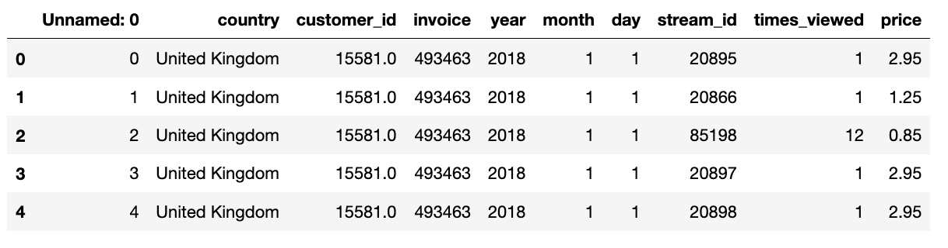
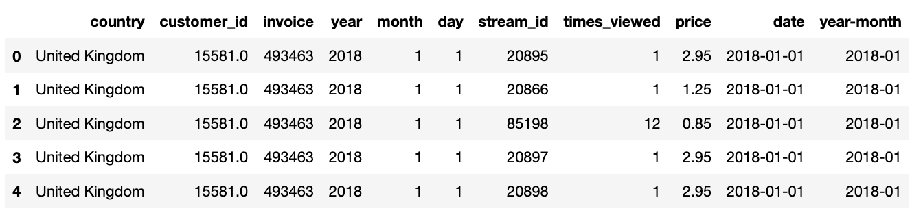
4.a) pre vs post manipulation

Slide 10
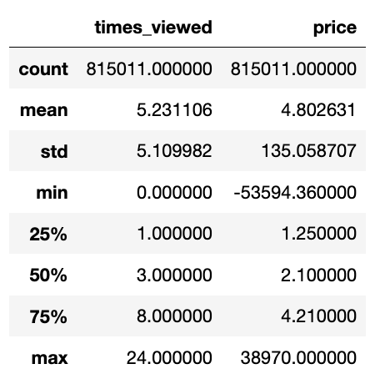
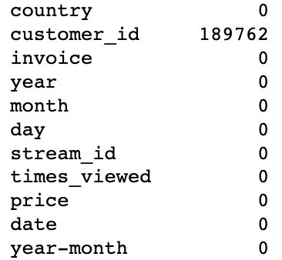
4.b) data shape, missing data and descriptive statistics
Descriptive statistics
Missing data counts
Data was assessed for structure, missing data, and descriptive statistics.
The data shape was (815011 rows by 11 columns).
Times_viewed IQR is between 1 and 8, the mean value is 5 and the median value is 3 (rounded).
Price IQR is between 1.25 and 4.21, the mean value is 5 and the median value is 2 (rounded).
Takeaways:
The total number of individual transactions is 815,011.
There were 189k missing customer ids (~25%/1 in 4 transactions).
The middle 50% of all transactions have customers viewing the stream between 1 and 8 times, and the average transaction has 3 or 5 views depending if mean or median is used.
The middle 50% of all transactions are priced between 1.25 and 4.21, and the average price of a purchased stream is 4.8 or 2.1, depending if mean or median is used.
The difference between median and mean shows that the data for both variables is likely skewed.

Slide 11
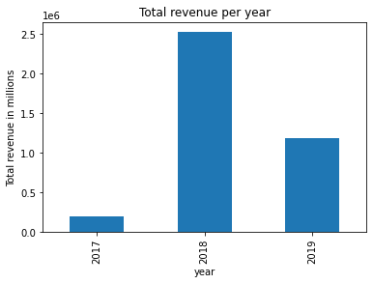
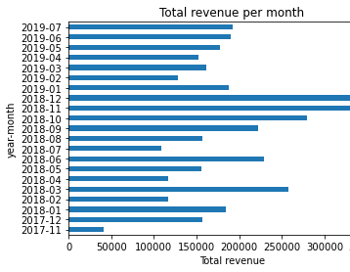
4.c) groupbys
The data was grouped by date, year, and month to allow aggregation of price(revenue) over time
The groupby of date was saved as ‘transactions_date_index.csv’
Total revenue company wide (across all countries) was visualized per year and month
Takeaways:
Most of the revenue came in 2018. The least revenue came in 2017, but expected as there was only 2 months data from 2017
Revenue peaked in the run up towards Christmas in 2018
Excluding Nov-17, Oct-18, Nov-18 and Dec-18 , monthly revenue for AAVAiL fluctuates between 100,000 and 275,000

Slide 12
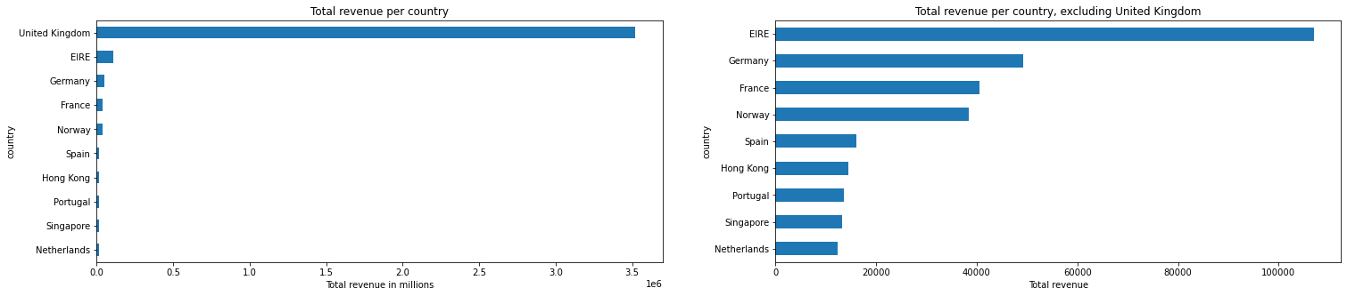
4.c) groupbys cont.
Data was also grouped by country, to find the top 10 revenue countries as specified in the business opportunity
Total revenue per country was calculated and ordered to produce this list of top 10 countries:
United Kingdom 3521513.51
EIRE 107069.21
Germany 49271.82
France 40565.14
Norway 38494.75
Spain 16040.99
Hong Kong 14452.57
Portugal 13528.6
Singapore 13175.92
Netherlands 12322.80
Revenue per country was visualised twice, excluding UK the second time to be able to compare countries 2-10.
Takeaway: UK has 32 times the total revenue than second highest Ireland (“EIRE”). Ireland has roughly double revenue of third place country Germany

Slide 13
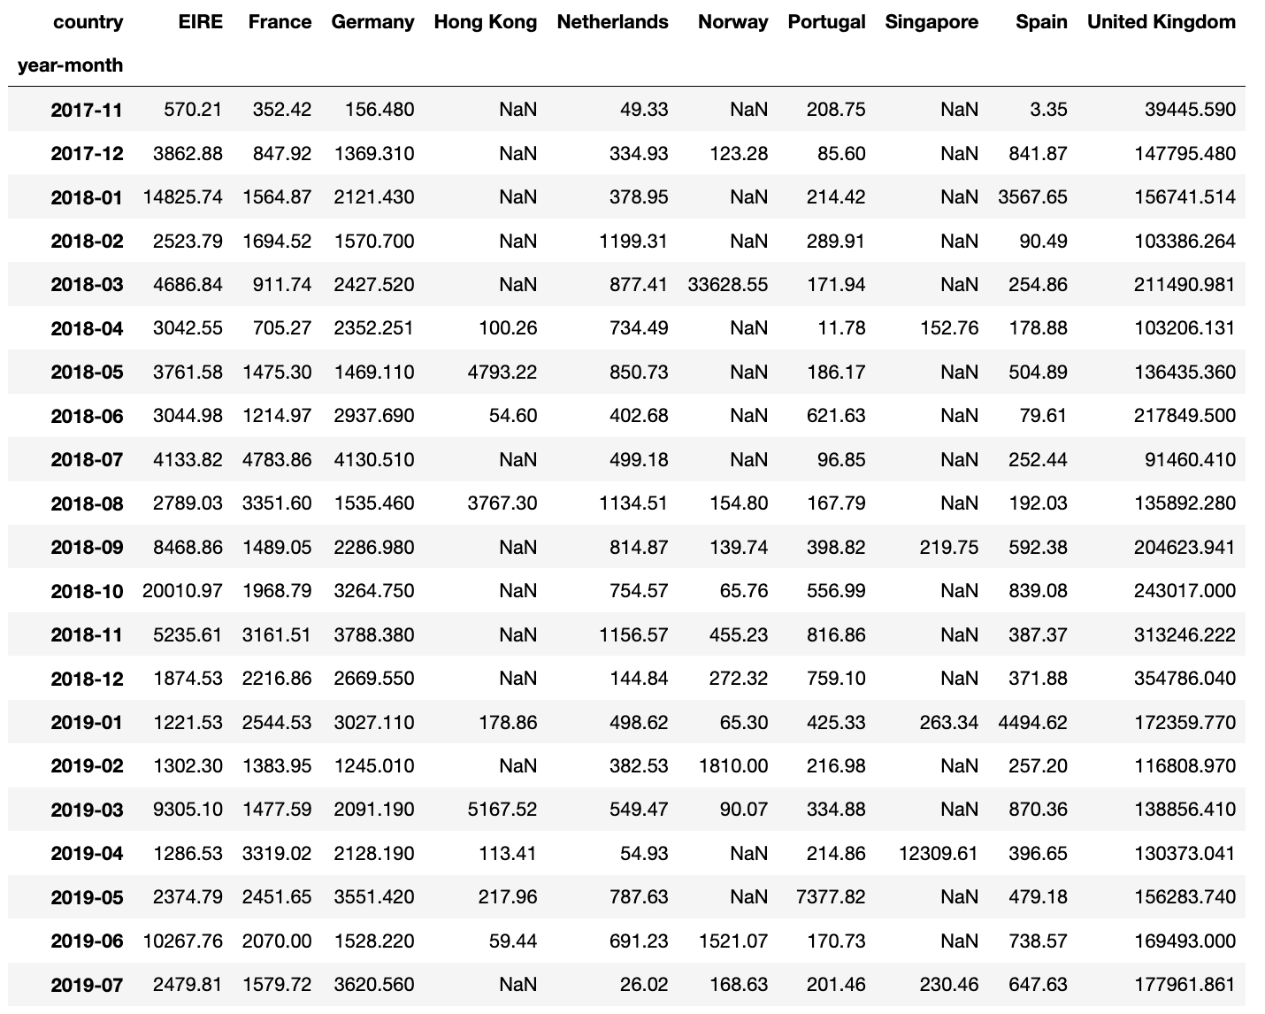
4.c) groupbys cont.
Data for these top 10 countries was grouped by country again, and indexed on month, to provide the monthly revenue totals per country.
This was saved as ‘monthly_revenue_totals_per_top10_country.csv’

Slide 14
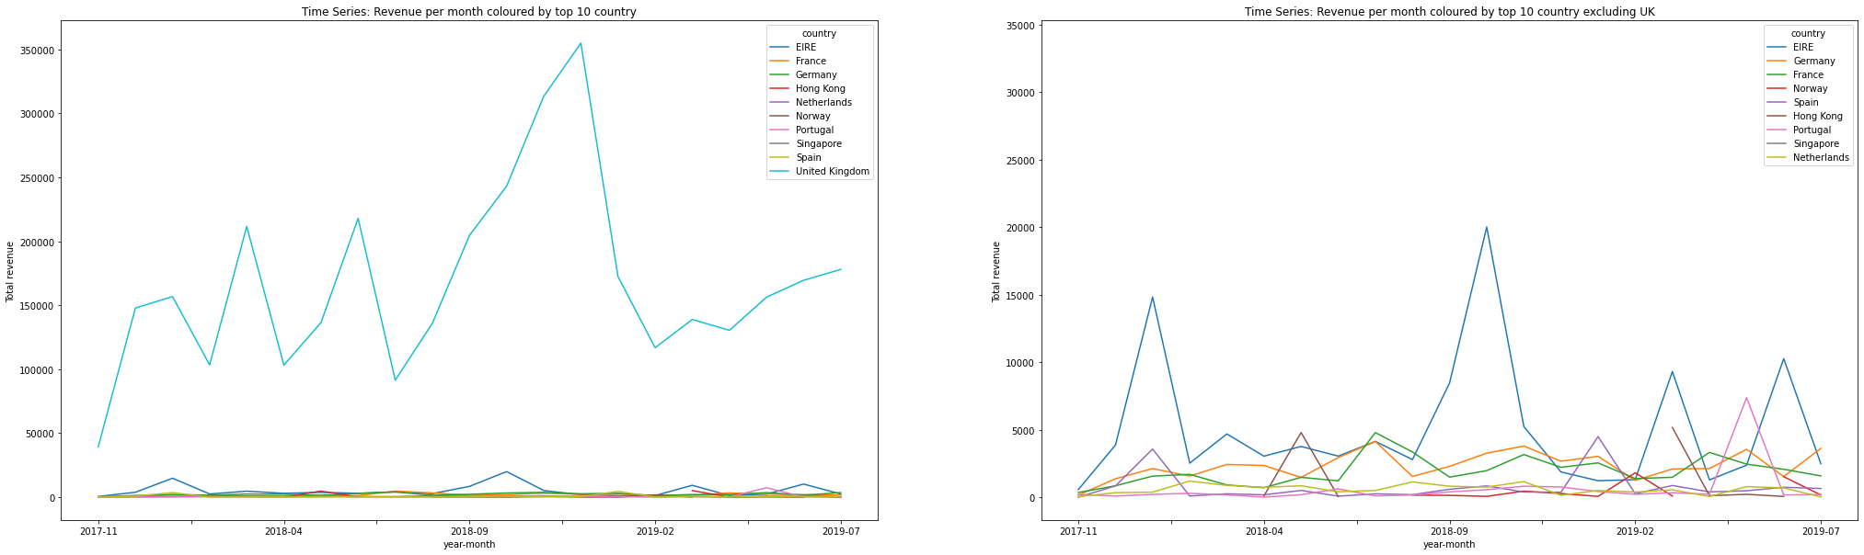
4.d) top 10 countries revenue per month visualised
This table was used to visualize revenues per top 10 countries over time as a time series/line graph.
Takeaways: Revenue for the UK peaks yearly around Christmas, and is between 100k and 250k outside of Christmas . This clearly shows month on month, the UK is the biggest market for AAVAiL.
Ireland’s revenue also peaks in December in 2017 & 2018. There are further spikes in March 2019 and June 2019, but outside of these peaks, stays below 5k / month.
Revenue for the other 8 countries doesn’t vary much and generally, stays below 5k a month.

Slide 15
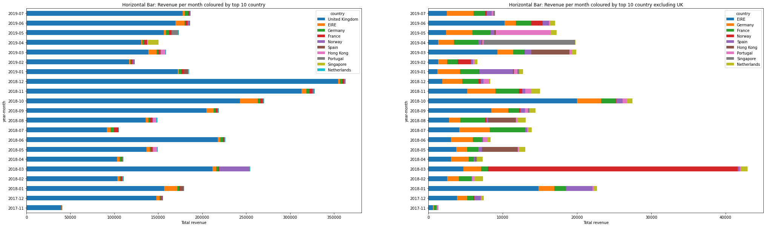
4.d) top 10 countries revenue per month visualized cont.
This table was also used to visualize revenues per top 10 countries over time as a stacked horizontal bar chart,
Takeaways: This graph shows what we learn from the previous slide, with the addition that Norway had 30k worth of transactions in March 2018.
The other notable points are Singapore’s large share of the company revenue in April 2019, and Portugal in May 2019.

Slide 16
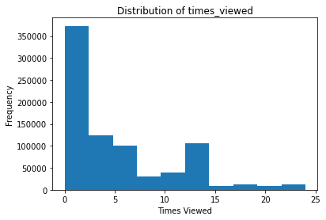
4.e) distributions of price and times_viewed
Histograms were plotted for the numeric variables, price and times_viewed, to view their distributions.
Takeaways:
For times_viewed, there was a wide range of streams with the max an individual stream was viewed being 24.
The majority was a single stream view (~350k), dropping to around 100k for 2-6 times, showing that most viewers only viewed a stream once after purchasing, and a smaller group of customers viewed up to a max of 6 times.
Interestingly, there is a second small peak at 100k for 14 views, suggesting perhaps a specific type, or grouping of streams was viewed 14 times.

Slide 17
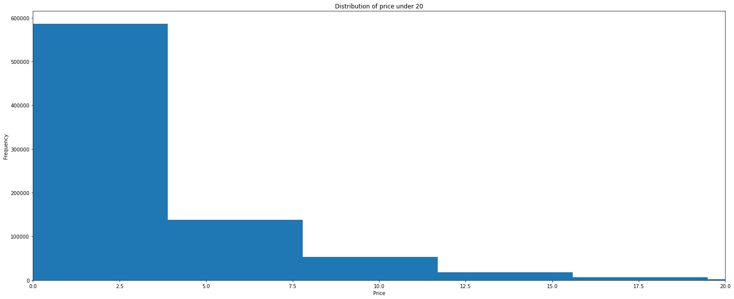
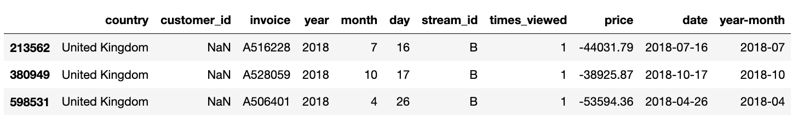
4.e) distribution of price and times_viewed cont.
Histograms were then plotted for price. On the first attempt negative transactions were shown. This was investigated further and 3 transactions were present with large negative values for price. The dataframe was subsetted with these values removed, and after multiple attempts to display price histogram, I had to use bins =10,000 and limit data to price < 20 to obtain a meaningful histogram.
Counts of transaction with price < 20, excluding negative values : 807,082 (99.1%)
Counts of transaction with price > 20 : 7,194 (0.9%)
Takeaways:
About 1 in 100 transactions is over 20 for price
The remaining 99% are under 20. Just under three-quarters (~75%) are under 3, showing that the majority of transactions are for low-cost streams. About 20% of these transactions are between 3 and 12. The remaining 4% are between 12 and 20.
Questions to discuss with AAVAiL data owners that would further help interpretation – what is the currency for price? If there are different currencies used e.g. GBP and EUE are these converted to the same equivalent currency? What do the 3 negative transactions represent?
Negative transactions

Slide 18
4.f) stream id and customer id investigations
Top 50
Stream_id | stream transaction count
85123A | 5017
22423 | 3661
85099B | 3313
21212 | 2801
20725 | 2610
21232 | 2414
84879 | 2305
47566 | 2259
22383 | 1989
21931 | 1985
84991 | 1957
21754 | 1930
20727 | 1920
21080 | 1897
22386 | 1866
22469 | 1851
22197 | 1846
22411 | 1830
20914 | 1824
22384 | 1782
21977 | 1772
21034 | 1727
22470 | 1714
22382 | 1707
82482 | 1701
20728 | 1681
22457 | 1677
82494L | 1672
22139 | 1666
20724 | 1663
20726 | 1609
85099F | 1601
22138 | 1597
21755 | 1592
85099C | 1583
22178 | 1569
21733 | 1566
21181 | 1563
20685 | 1555
21843 | 1550
22090 | 1532
48138 | 1522
POST | 1519
21790 | 1466
22355 | 1465
84946 | 1456
21231 | 1431
22077 | 1424
21175 | 1390
22379 | 1354
Customer_id | customer transaction count
17841.0 | 8809
14911.0 | 8182
14606.0 | 5763
12748.0 | 4560
15311.0 | 3837
14156.0 | 3517
14646.0 | 2853
13089.0 | 2851
17850.0 | 2827
15039.0 | 2506
14527.0 | 2418
14298.0 | 2323
16549.0 | 2307
13081.0 | 2149
15005.0 | 2105
16782.0 | 1867
17511.0 | 1660
17377.0 | 1497
15719.0 | 1456
17920.0 | 1408
14680.0 | 1377
13694.0 | 1339
12681.0 | 1327
13564.0 | 1318
12921.0 | 1313
15998.0 | 1282
17589.0 | 1281
14159.0 | 1258
15555.0 | 1255
13263.0 | 1249
15768.0 | 1232
14505.0 | 1232
14796.0 | 1191
13230.0 | 1186
18118.0 | 1170
14667.0 | 1158
17448.0 | 1134
13093.0 | 1111
16713.0 | 1075
17338.0 | 1064
13174.0 | 1060
17611.0 | 1029
12471.0 | 1025
13069.0 | 1025
16984.0 | 1019
17231.0 | 1007
17238.0 | 1006
14415.0 | 999
16161.0 | 994
13001.0 | 993
Stream and customer id columns were investigated to see how many unique streams and customer existed within the ~800k transactions
Unique stream ids: 5,007
Unique customer ids: 5,226
The top 50 streams and customers in terms of number of transactions have been listed for AAVAiL stakeholders to be aware of, and to show their most popular streams and most loyal customers.
Takeaway: there are only ~5k unique streams and customers across the 800k transactions, suggesting a lot of repeat business from customers

Slide 19
4.g) country investigations
 | country transaction count
United Kingdom | 751228
EIRE | 13577
Germany | 13336
France | 9899
Netherlands | 4024
Spain | 2606
Switzerland | 2326
Belgium | 2166
Portugal | 1815
Australia | 1543
Channel Islands | 1287
Sweden | 1156
Italy | 1049
Cyprus | 907
Norway | 796
Finland | 749
Austria | 719
Denmark | 629
Greece | 627
Unspecified | 614
Japan | 514
United Arab Emirates | 462
Poland | 429
Singapore | 310
Hong Kong | 276
USA | 266
Canada | 223
Malta | 219
Iceland | 195
Lithuania | 189
Israel | 139
Bahrain | 126
RSA | 111
Brazil | 94
Thailand | 76
Korea | 63
European Community | 61
Lebanon | 58
West Indies | 54
Bermuda | 34
Nigeria | 32
Czech Republic | 17
Saudi Arabia | 10
Countries were investigated to see how many unique countries existed within the ~800k transactions
There were 43 unique countries.
The transactions count is displayed adjacent.

Slide 20
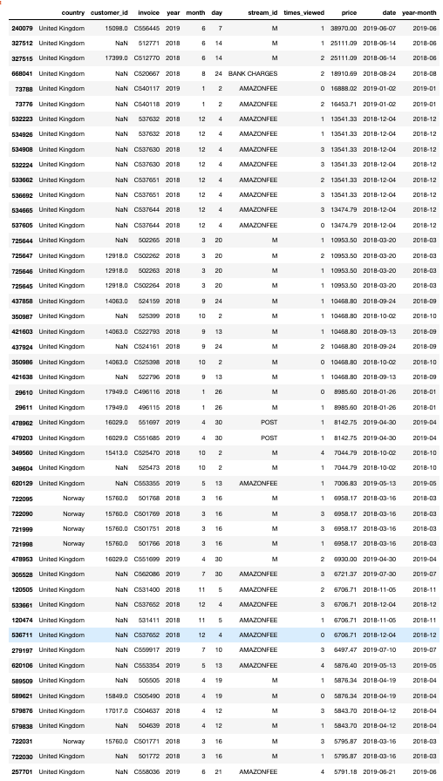
4.h) top 50 price transactions
Following price investigations, transactions were sorted by price, cut from the top 50 , and investigated further.
Takeaways:
All transactions come from the UK, except some from Norway on 16 March 2018
Stream ids are 'M', 'AMAZONFEE', 'POST' and there is one large transaction 'BANK CHARGES’
These transactions are dispersed across the population dataset time window 2017-2019, showing that high volume transactions occur across all months

